Slide 1
Design And Analysis of Algorithms
Department of Information Technology
-----Group Members-----
Suhaib Khan(IIB2019039)
Sangam Barnwal(IIT2019094)
Sanjana Reddy (IIT2019095)
ASSIGNMENT-4 DEMOSTRATION

Slide 2
OUTLINES
Introduction
Problem Statement
Divide and Conquer
Experimental Analysis
Conclusion
References

Slide 3
Problem Statement
“Given an array and a value x,the problem is to find the floor of x which is the largest element in the array smaller than or equal to x.In this paper,we will see the algorithm using divide and conquer approach to solve the problem.Then we will analyse the time complexity of the algorithm.We will see a O(log n) solution which will be much faster than the brute force approach. “

Slide 4
INTRODUCTION
We are given an array and a value x whose floor is to be found.A naive solution can be to traverse through the array and find the first element greater than x. The element just before the found element is the floor of x.This is similar to linear search and gives the O(n) solution.If this solution uses linear search ,we can get the intuitive idea of using binary search to solve the problem efficiently

Slide 5
Divide and Conquer
Divide and Conquer is an algorithmic paradigm. A typical Divide and Conquer algorithm solves a problem using following three steps.
Divide: Break the given problem into subproblems of same type.
Conquer: Recursively solve these subproblems.
Combine: Appropriately combine the answers.

Slide 6
Algorithmic Steps
Create three variables l = 0, mid and r = n-1.
Recurse until and unless l is less than r.
check if the middle ( l + (r-l) /2) element is equal than x, if yes then return the mid index.
else check if middle element is greater than x ,if yes then update the r, i.e r = mid - 1, and recurse. In this step we are reducing the search space to half.
Else update the l, i.e l = mid +1 and recurse.
when l ≥r ,return l.
If arr[l] = x,floor = x.
If arr[l] < x,floor = arr[l].
If arr[l]> x and l!= 0, floor = arr[l − 1]
else floor not present.

Slide 7
Algorithmic Analysis
APRIORI ANALYSIS: We have tried to do the Apriori Analysis of the approach based on Divide and Conquer. Let T(n) and S(n) is the time and space respectively.
TIME COMPLEXITY DERIVATION: Let Time complexity of above algorithm be T(n). In the base case the funtion compares l,r and returns which takes constant time.Otherwise, comparison and calculation of the middle element will take constant time and then the problem is divided into another problem of size n/2 (either floorSearch(arr, l, mid - 1, x) or floorSearch(arr, mid + 1, r, x).

Slide 8
code
#include <bits/stdc++.h>
using namespace std;
int floorSearch(int arr[], int l, int r, int x) {
if (r > l) {
int mid =(r + l) / 2;
if (arr[mid] == x)
return mid;
if (arr[mid] > x)
return floorSearch(arr, l, mid - 1, x);
return floorSearch(arr, mid + 1, r, x); }
if(r<=l)
return l; }

Slide 9
int main(void) {
int n;
cin>>n;
int arr[n];
int x ;
cin>>x;
for(int i=0;i<n;i++)
cin>>arr[i];
int result =floorSearch(arr, 0, n - 1, x);

Slide 10
if(arr[result]==x)
cout<< x;
else if(arr[result]<x && arr[result+1]>x)
{cout<< arr[result];}
else{
if(arr[result]>x&&result!=0)
cout<< arr[result-1];
else
cout<<-1;}}

Slide 11
Time Analysis
T(n) = T(n/2) + c
Using above relation, we get for T/2, T/8 etc as:
T(n/2) = T(n/4) + c
T(n/4) = T(n/8) + c
T(n/8) = T(n/16) + c
and so on. . . . . . . . . .
T(n)=T(n/2k )+c+c+c...+c
when n=2k ,T(n)=T(1)+c*log2n

Slide 12
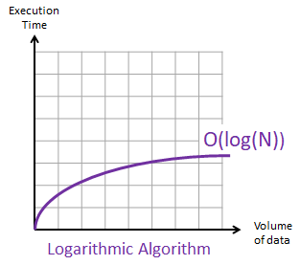
Time Analysis O(logn)
Figure 3: Time Analysis

Slide 13
Space Analysis
By the experimental analysis, we found that in case of optimized approach, on increasing value of n (increasing the number of elements in array) the graph is strictly increasing Thus the overall space increases with an increase in no. of elements

Slide 14
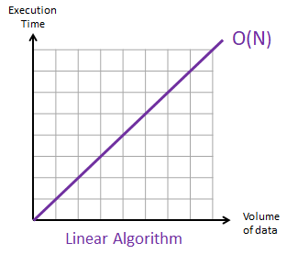
Space Analysis O(n)
Figure 4: Space Analysis

Slide 15
Conclusion
So, with the above mentioned algorithms and their profiling, we come to the conclusion that this problem of finding the floor of a given number in a sorted array is achieving its best time complexity of O(logn) and space complexity of O(n).

Slide 16
References
1. Introduction to Divide and Conquer Technique: https://www.geeksforgeeks.org/divide-andconquer-algorithm-introduction/
2. Introduction to Algorithms by Cormen,Charles, Rivest and Stein.
https://web.ist.utl.pt/ fabio.ferreira/material/asa

Slide 17
THANK YOU !!

